Slide 1
OS function's & uses
Notes:
Оригинальные шаблоны для презентаций: https://presentation-creation.ru/powerpoint-templates.html
Бесплатно и без регистрации.
<number>

Slide 2
5 main function's
1
Processor Management
2
Memory Management
3
I/O Device Management
4
Storage Management
5
Security & Protection

Slide 3
Little about the operating system
User
OS
Hardware
Ex of resoure manager
CPU
Memory
I/O devices
OS manage or locate this resources
into some process (ex: Memory manag.)

Slide 4
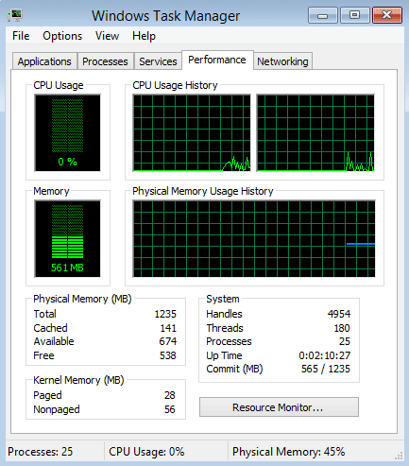
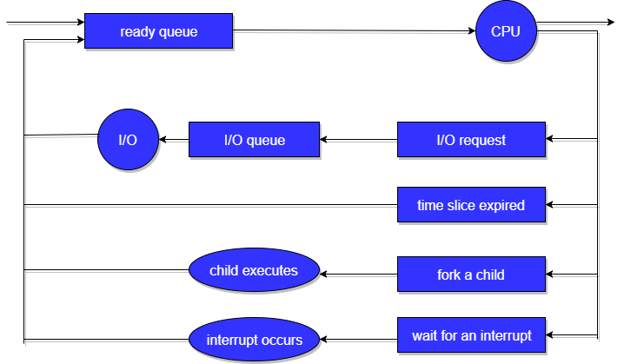
Processor Management(Scheduling)
In a multi programming environment, the OS decides the order in which processes have access to the processor, and how much processing time each process has. This function of OS is called process scheduling. An Operating System performs the following activities for processor management.
F.e: Task manager
It shows to you processes running on your computer

Slide 5
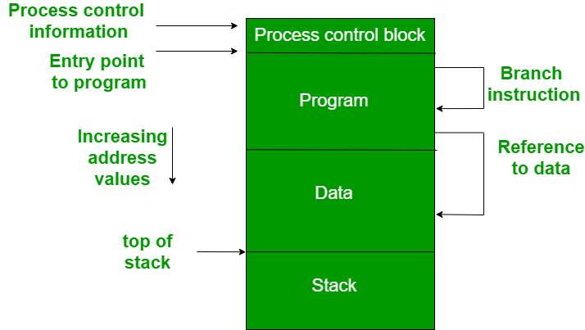
Memory Managment
The operating system manages the Primary Memory or Main Memory. Main memory is made up of a large array of bytes or words where each byte or word is assigned a certain address. Main memory is a fast storage and it can be accessed directly by the CPU. For a program to be executed, it should be first loaded in the main memory. An Operating System performs the following activities for memory management:
User
Application
Operating System
Hardware

Slide 6
I/O device managment
An OS manages device communication via their respective drivers. It performs the following activities for device management. Keeps tracks of all devices connected to system. designates a program responsible for every device known as the Input/Output controller. Decides which process gets access to a certain device and for how long. Allocates devices in an effective and efficient way. Deallocates devices when they are no longer required.
F.e:
User 1
1 act
Printer
User 2
2 act
User 3
3 act

Slide 7
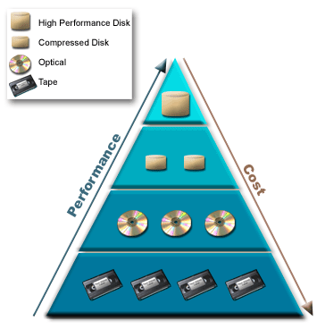
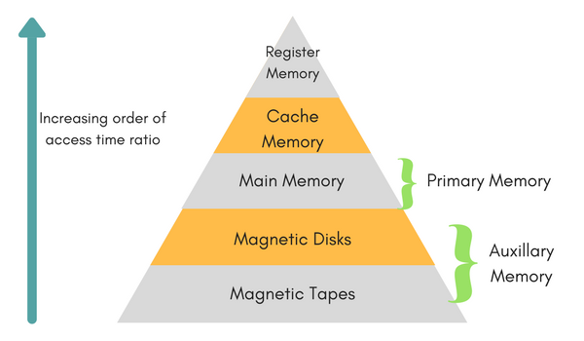
Storage managment (File managment)
A file system is organized into directories for efficient or easy navigation and usage. These directories may contain other directories and other files. An Operating System carries out the following file management activities. It keeps track of where information is stored, user access settings and status of every file and more… These facilities are collectively known as the file system.

Slide 8
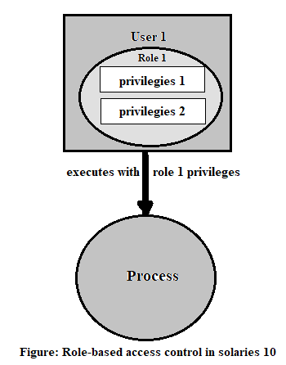
Security & Protection
The operating system uses password protection to protect user data and similar other techniques. it also prevents unauthorized access to programs and user data.

Slide 9
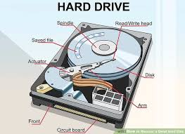

Uses or example comparing life with/without OS
Life without an OS
Life with an OS
Where is this file on disk?
file = open (“text.txt”,
O_WRONLY);
write (file, “test”, 4);
close(file;)
Which platter , sector?
Code needs to change on
a different type system

